Slide 1

Measurement of the Secretion Dynamics of Insulin from Islets of Langerhans Using a Microfluidic Device
_________________
PITTCON 2014 Chicago, IL
__________________________________
Nikita Mukhitov, Lian Yi, Michael G. Roper
Roper Research Group
Florida State University
March 6th 2014
Notes:
43:30

Slide 2
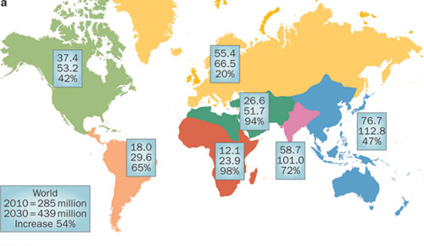
The Diabetes Epidemic
285 million people in the world have diabetes
Age of T2DM onset is getting younger
Additional Complications:
1. Diabetic retinopathy (blindness)
2. Cardiovascular disease
3. Stroke
Diabetes: the inability to maintain glucose homeostasis
Chen, L et al. Nature Reviews Endocrinology, 2012, 8, 228-236.

Slide 3
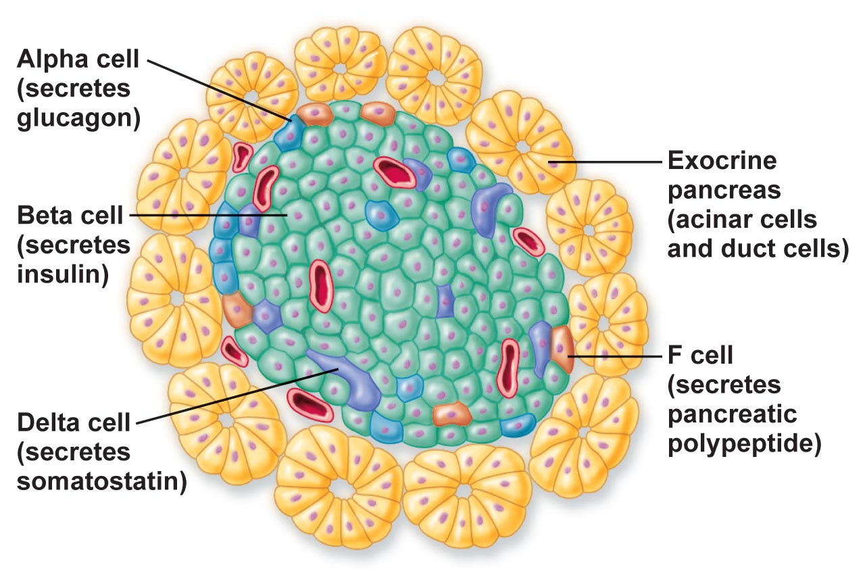
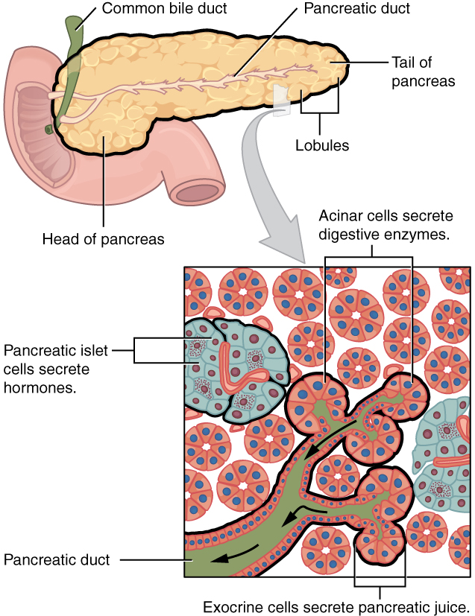
Studying the Islets of Langerhans
Islet composition
  ~ 80 % beta cells
  Islet ~ large beta cell
Study the islets’ insulin response to incoming glucose levels

Slide 4
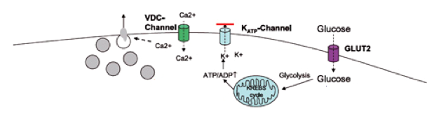
A Look Inside the Beta Cell
Glucose Stimulated Insulin Secretion (GSIS)
Insulin Secreted
How to monitor insulin?
  via Ca²⁺ with fluorescent dyes
  directly with ELISA
Secretion from the individual islets is oscillatory
http://www.igis.com/igis-digest/xith-igis-symposium/er-and-the-canonical-unfolded-protein-response-upr/
Ravier, M. A.; Sehlin, J.; Henquin, J. C. Diabetologia 2002, 45, 1154-1163.
Notes:
Emphasize that data from single islet

Slide 5
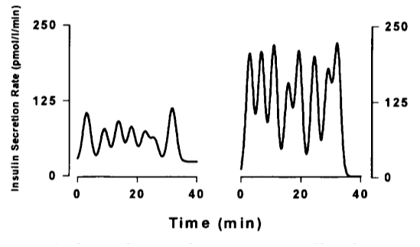
Islet Synchronization
Islets must be synchronized !!!
- If out of phase, oscillatory nature is lost
x 1,000,000
?
Single Islet
Pancreas
Ravier, M. A.; Sehlin, J.; Henquin, J. C. Diabetologia 2002, 45, 1154-1163.
Song, S. H. et al. J. Clin. Endocrinol. Metab. 2000, 85, 4491-4499.

Slide 6
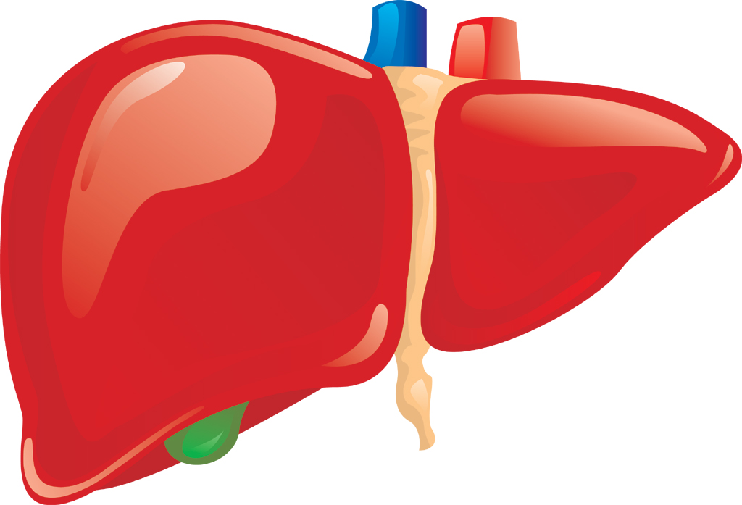
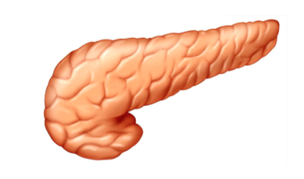
Liver-Pancreas Feedback
Insulin Response
Glucose
Liver
Pancreas
Insulin
The islets’ insulin response synchronizes with the glucose stimulation and vise versa

Slide 7
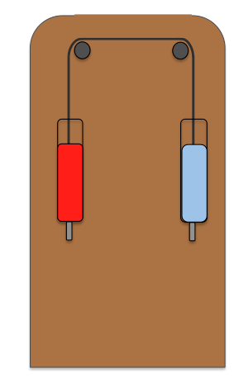
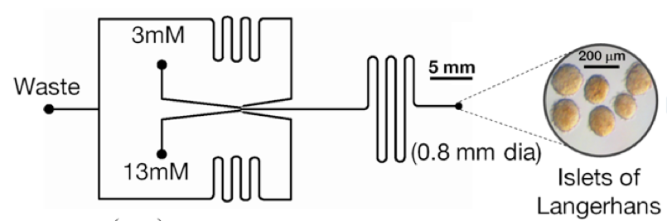
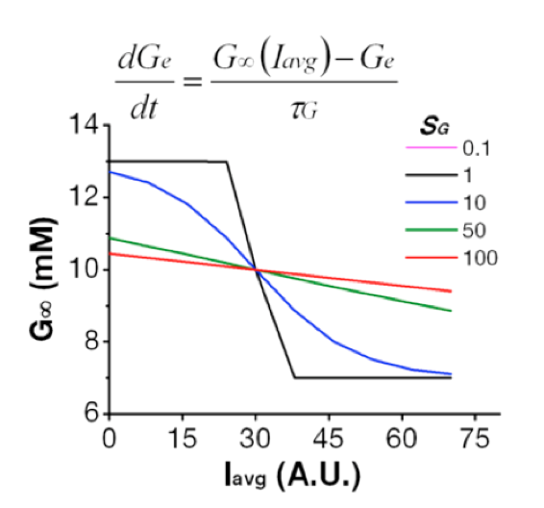
The Feedback Loop
Keep iterating until synchronization achieved
4. Calculate expected change
in [glucose]
1. Deliver [glucose] to islet
6. Deliver new [glucose] to islet
3. Utilize model
to predict liver response
2. Monitor insulin as f(Ca²⁺) secretion
Microfluidic Chip
Notes:
Deliver glucose to islets

Slide 8
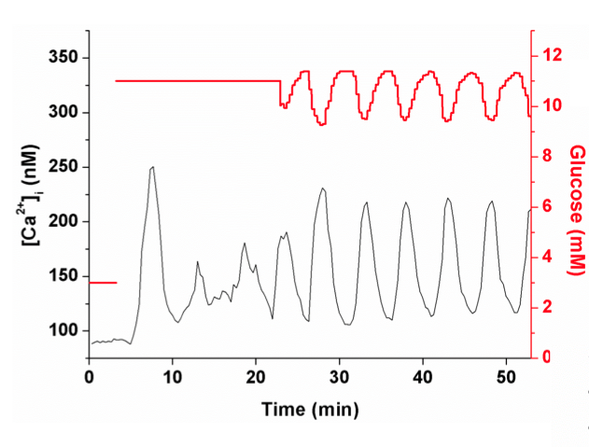
The Feedback Loop
Closed
(1) Monitor Ca²⁺ with constant glucose
(2)Apply model to mimic liver response
Average calcium for five islets
The islets synchronize with the “liver”
Feedback established
Data provided by Raghu Dhumpa

Slide 9
Purpose: Measure insulin release under this dynamic interaction
Insulin
How: Integrate previously developed methods for glucose
delivery and measurement of insulin secretion
Notes:
Integrated system → have the islet in a viable condition and to minimize dilutions and to have a sensitive screening…
Get rid of the islet stimulated by glucose

Slide 10

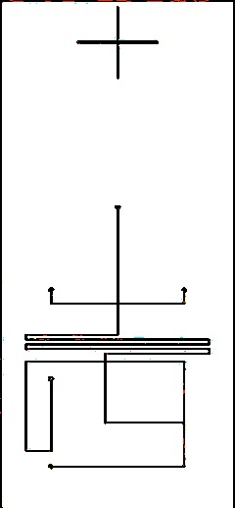
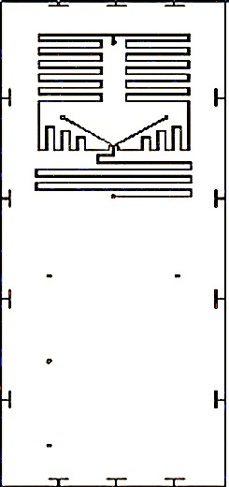
Microfluidic Device
Perfusion Layer
On the Top;
~35 um deep and ~160 um wide
-Attach reservoirs with
Epoxy adhesive
EOF Layer
On the bottom;
~5 um deep and ~13 um wide
2.5 cm
Photolithography facilitated with OAI equipment
Notes:
Emphasize that the perfusion is the new addition
I will talk about the new accessory first and then transition to how it is integrated with our chip
“I will introduce the comp immunoassay but the neat aspect is how we dliver the glucose concentrations…”

Slide 11
Development of Cellular Perfusion System
Flow is a function of syringe height on axis
Very smooth flow
Total flow rate is constant (~1.1 uL/min)
Syringes are calibrated to the axes position

Slide 12
Delivery of Complex Glucose Waveforms
Objective:
Deliver glucose with perfusion system to mimic the liver response
Must be able to precisely generate appropriate desired periods and amplitudes of waves.
Need to quantify and minimize distortion by dispersion.
Notes:
8-11 mM Glucose Sine Wave
Explain better the cutoff frequency figure
Get rid of the fit for the plot
Conservative

Slide 13
Delivery of Complex Glucose Waveforms
Attenuation due to dispersion
Ideal
Actual
Ideal
Ideal
Actual
Actual/Ideal
Notes:
8-11 mM Glucose Sine Wave
Explain better the cutoff frequency figure
Get rid of the fit for the plot
Conservative

Slide 14
Perfusion successfully characterized and now to check integration

Slide 15
Microfluidic Device
Cellular Perfusion
Islet
- Temperature maintained at 37 C
Antibody
Insulin-Cy5
“Gate”
Injection = 1 second
Separation ~ 13 seconds
-4.5 kV
Waste

Slide 16
Integration of Perfusion System
Cy5
Buffer
Dictating the delivery upstream
Sampling downstream in separation channel
Notes:
We will need to sample from ALL THE WAY upstream from the islet to the sep. channel and need to ensure COMPLETE integration
First show only the red and then switch to both with the signal\
Write time on z axis/period

Slide 17
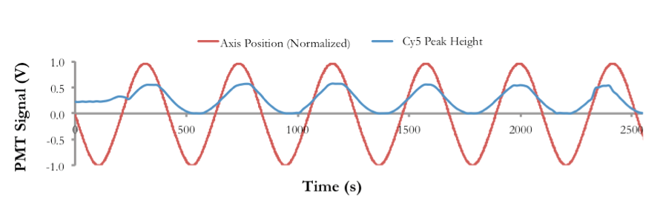
Integration of Perfusion System
Cy5
Buffer
Notes:
We will need to sample from ALL THE WAY upstream from the islet to the sep. channel and need to ensure COMPLETE integration
First show only the red and then switch to both with the signal\
Write time on z axis/period

Slide 18
Integration complete sampling, separation and detection
+ cellular perfusion system
_____________________
Apply to studying the islets

Slide 19
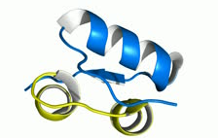

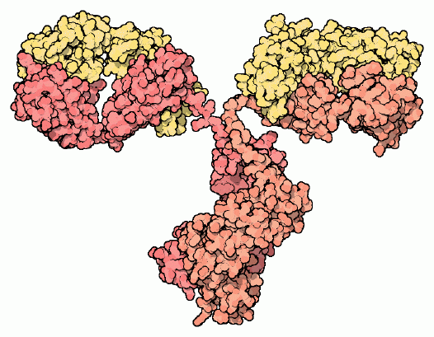
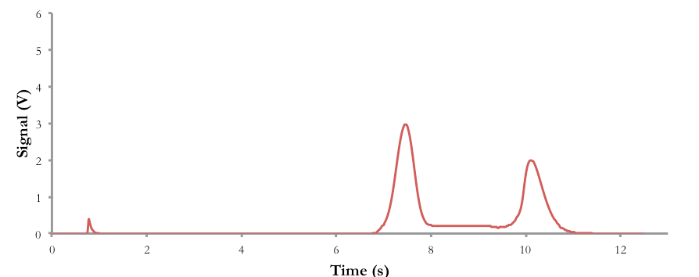
Competitive Immunoassay
Ab
Ins
Ins*
Ab-Ins
Ab-Ins*
Ins
Ins*
Ins
Ab-Ins*
Ins*

Slide 20
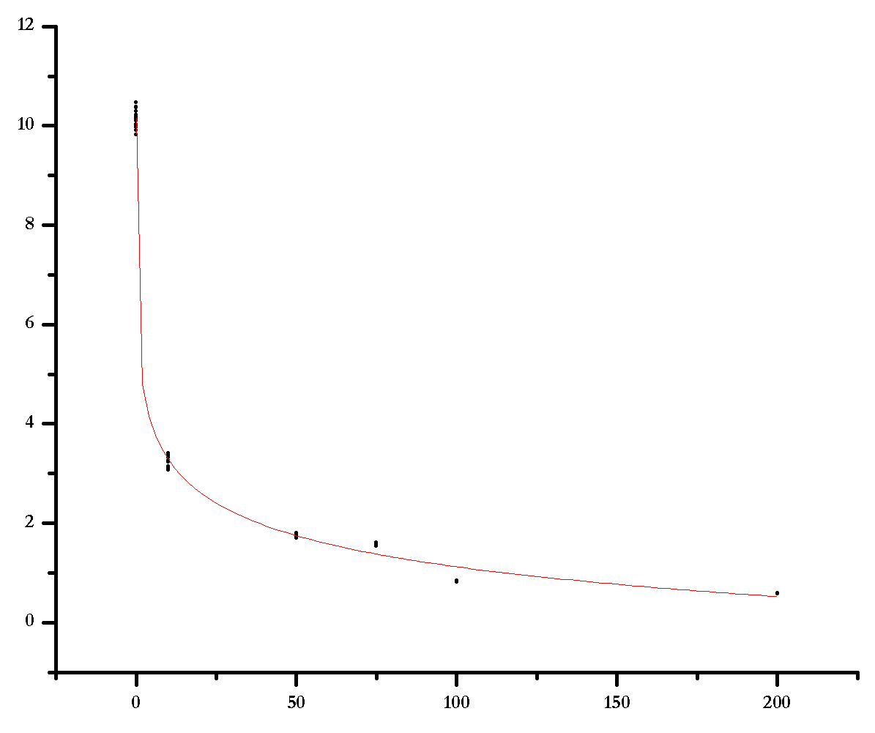
B/F Calibration Plot
Conditions:
  [Ab] = 150 nM
  [InsCy5] = 150 nM
  [Ins] = 0 - 200 nM
Buffers
  PETA for samples
    20 mM phosphate, 1mM EDTA, pH 7.4, Tween (0.1% w/v), BSA (10% v/v)
  Carbonate for separations
    20 mM sodium carbonate and bicarbonate, pH 9.0
LOD ~ 0.3 nM
Bound/Free
[Insulin] (nM)
Notes:
Problems with stabilizing the B/F and there is drift over time.

Slide 21
Summary and Conclusion
The perfusion system delivers new [glucose]
  Stimulate islets with glucose
  Response of liver factored in with mathematical model
Quantify insulin
  EOF sampling and competitive immunoassay
The chip contains islets
  Pancreatic response to the liver
Notes:
Issues for drift → pH (constantly applying voltage, non homogeneous temperature, non specific binding).

Slide 22
Future Work
The stabilization of the immunoassay should yield more reproducibility.
  Apply the competitive immunoassay to real time analysis of islet dynamics.
Utilize system on multi islet analysis.
Implement the insulin secretion data into model revision.

Slide 23


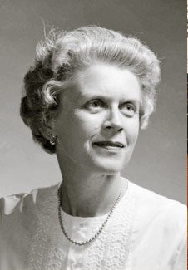
Acknowledgements
Group
My group members for their patience, support and assistance in brainstorming:
  Lian, Adrian, Raghu, Tuan and Xue.
My PI, Mike Roper, for his support, guidance and motivation.
Funding
OAI Presentation Grant
NIH
Florida State University
Hoffman Fellowship

Slide 24
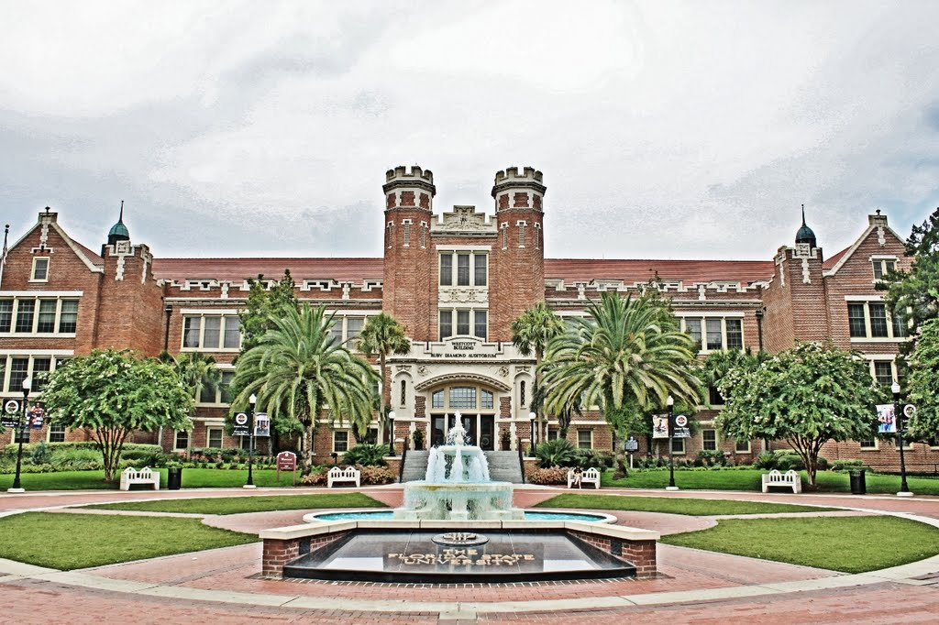
Thank you for your time and questions

